Slide 1
Programming, problem solving And Reasoning

Slide 2
Agenda
Admin information about the course
Software Installation
Our first C program
The C language elements introduced today
Syntax and evaluation internally
Abstraction and programming

Slide 3
Software Engineering Courses
Sem. | Lecture | ECTS | Main Focus
1 | Introduction to Programming | 10 | Problem solving, programming in C
2 | Comp. Engineering Project I | 5 | Group work, embedded software
2 | Software Architecture | 5 | System & application software and emerging patterns
2 | Discrete Mathematics | 5 | Abstraction and proof
3 | Algorithms & Data Structures | 5 | Abstraction and efficiency
3 | Comp. Engineering Project II | 5 | Planning, organizing, distributed software
3 | Distributed Systems | 5 | Software for pervasive elements
3 | Software Engineering | 5 | Essential software technologies
4 | Programming and Modelling | 10 | Cyber-physical systems modelling, code generation

Slide 4
The computer engineering study
Digitale kredsløb
Computer-teknologi
projekt 1
HW/SW
co-design
Computer-teknologi
projekt 2
Programmering for Computer Engineering
Computer arkitektur
Distribuerede systemer
Computer netværk
Software arkitektur
Software engineering
Regulering
Klassisk fysik
Diskret matematik
Algoritmer og datastrukturer
Programmering og modellering
Calculus (Beta)
Numerisk lineær algebra
Sandsynligheds-
teori og statistik
Differential-
ligninger
Diskrete signaler og lineære systemer

Slide 5
ProgrEssion
The course design is coordinated to ensure progression from one course to the next
This begins with fairly trivial decisions: Limit the number of programming languages
We have decided for the core language C
The curriculum builds skills in cross-cutting themes for which there is no specific course
The most important are
Problem solving: from small scale to large scale
Modelling: from abstraction of computers to abstraction of programs
Reasoning: from informal understanding to formal rigour
Verification: from understanding correctness to ensuring correctness

Slide 6
Cross-cutting themes
Sem. | Lecture | PS | MD | RS | VR
1 | Introduction to Programming | X |  | X | X
2 | Comp. Engineering Project I | X
2 | Software Architecture | X | X
2 | Discrete Mathematics |  | X | X | X
3 | Algorithms & Data Structures | X | X | X
3 | Comp. Engineering Project II | X | X | X
3 | Software Engineering | X |  |  | X
3 | Distributed systems | X
4 | Programming and Modelling | X | X | X | X
Abbreviations
Problem solving (PS) Modelling (MD)
Reasoning (RS) Verification (VR)

Slide 7
Student characteristics
All students should receive support
We distinguish the learning levels of students: weak, regular, strong
We offer a programming café every week where all students will receive help with the lecture material from the current week
In particular, weaker students benefit from such offers
Students get help with tools, review exercises and past exercises
Recordings of the lectures will be available, in particular, for the weaker students
Exercises for every week will have different difficulty levels with a challenge exercise for the strong students (the challenge exercise is not obligatory and open to all)
In week 4 of the course, a voluntary programming project will be offered to all students
We expect that this will mostly be taken on by regular and strong students
The students decide which offers they take up

Slide 8



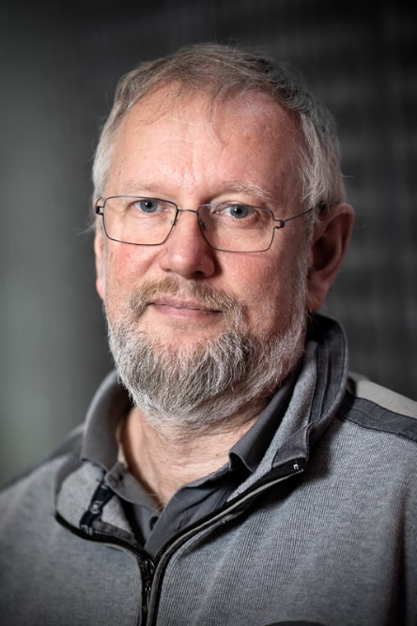
Who are we?
Professor Peter Gorm Larsen; MSc, PhD
Worked 17 years in industry (IFAD, Systematic); at IHA/AU since 2005
Reviewer for EU and other countries on Research projects and applications
Consultant for most large defence contractors on large complex projects
Mostly proud of the firmware of NFC chip in 250+ million phones
Served on 70+ program committees both as member and as chair
Supervision: 9 post-docs, 11 PhD students, 60 MSc thesis students
Has written books and 180+ articles (in particular about VDM and CPS)
Member of the Danish Research Council for Independent Research (FTP)
Coordinating INTO-CPS (8M€) + take part in 4 other externally funded projects
Lead the AU Centre for Digital Twins due to grant from the PDJ Foundation
See http://pure.au.dk/portal/da/pgl@eng.au.dk for details

Slide 9

Who are we?
Stefan Hallerstede: MSc, PhD
3 years at Start-Up in Grenoble
3 years at ETH Zürich
1 year at University of Southampton
3 years at University of Düsseldorf
8 years at Aarhus University
http://pure.au.dk/portal/en/persons/stefan-hallerstede(65c96a3f-b4af-473c-a0d8-7909b2f2903c).html

Slide 10


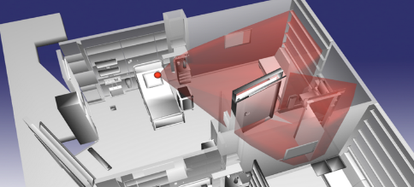
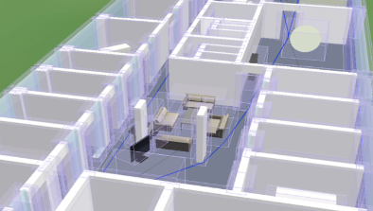
Who are we?
Carl Schultz; PhD
A kiwi! (from New Zealand)
Previously postdoc in Uni Bremen (Germany) and
Uni Münster (Germany)
PhD Uni Auckland (New Zealand)
Co-founder DesignSpace research consultation group
Artificial Intelligence for Architecture, Engineering, Construction
http://pure.au.dk/portal/da/cschultz@eng.au.dk
http://www.design-space.org/
http://www.design-space.org/edra45
Main responsible for the exercises

Slide 11
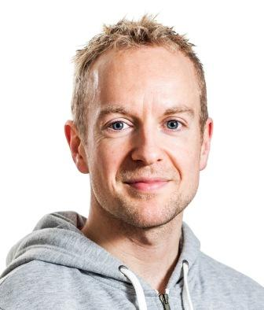
Peter Tran-Jørgensen
Post-doc, Software Engineering (since 2016)
PhD within formal methods code-generation (2013 - 2016)
Lead developer/release manager of the Overture tool
Office: Turing-122
Email: pvj@eng.au.dk

Slide 12

Casper Thule
Post-doc, Software Engineering (Awaiting PhD Defense)
Lead Developer of Maestro, a Co-simulation Framework
Full-stack developer
Older than appears on picture
C is extremely important as communication baseline for interoperability
Office: Turing-122
Email: casper.thule@eng.au.dk

Slide 13
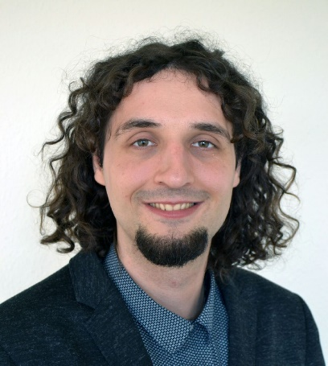
Tomas Kulik
PhD student within the area of security of Industrial Internet of Things
Done MSc in standardization of communication within Internet of Things
7 years of experience as a software developer of SCADA systems
Office: 124 in the Turing building
Contact: tomaskulik@eng.au.dk

Slide 14
Contacting details
The most convenient way – email pgl@eng.au.dk
Or see me in my office. We all live in the the Turing building
I am in room 121.
For exercise contact Carl Schultz (email cschultz@eng.au.dk)
He is in room 123.

Slide 15
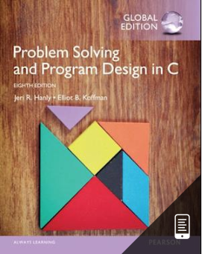
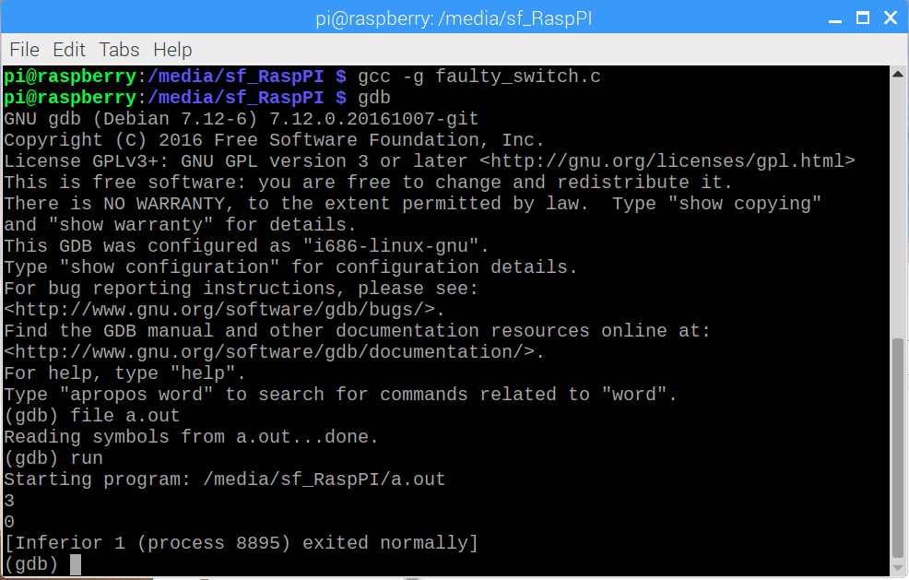
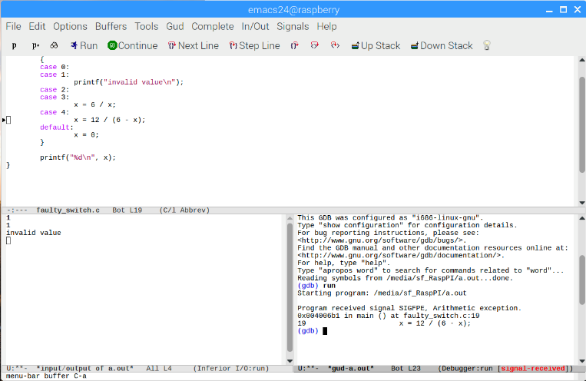
Teaching material
Problem Solving and Program Design in C, Hanly, Koffman
Virtual Box image with common C compiler
Weekly exercises for programming cafés
Mandatory exercises that must be handed in and approved
Slides and recording of lectures
Optionally challenge project
Terminal
Emacs

Slide 16
Course web pages
All information concerning this course including lecture notes, assignments announcements, etc. can be found on the course web pages at BlackBoard (www.bb.au.dk)
You should check this site frequently for new information and changes. It will be your main source of information for this unit. The layout of the web pages should be fairly self explanatory
Please let me know if you don’t have access

Slide 17
Educational form
Confrontation with the teacher
Tuesdays 8:15 – 12:00 lecture in Room 120 in the Edison building
Thursdays 12:15 – 16:00 (also 120) Mostly programming cafes + feedback on exercises
Combination of
Lessons teaching theory
Interspersed with sessions using tools on the command-line
Programming cafés
Mostly weekly mandatory exercises
Exam form
Written exam (3 hours) without any material

Slide 18
Learning objectives
At the end of the course, the participants will be able to:
describe and discuss commands and control structures of imperative programming;
describe and discuss structuring mechanisms in different programming styles;
implement their own programs using different programming paradigms;
explain the concept of functional programming;
describe assertional techniques for reasoning about programs;
reason informally about programs and relate to tests.

Slide 19
Structure of weeks
The covered material concerning programming concepts is standard
Cross-cutting themes are treated alongside:
Reasoning begins in week 1
Verification begins in week 2
Course elements
Lectures
Programming cafés
Exercise feedback
Week | Topic | Contact Hours
1 | Basics | 4L + 4C
2 | Repetition | 4L + 4C
3 | Testing and Debugging | 4L + 2C + 2E
4 | Problem Solving | 4L + 2C + 2E
5 | Structured Data | 4L + 4C
6 | Modules and Scope | 4L + 2C + 2E
7 | Libraries | 4L + 2C + 2E
8 | Algorithms | 4L + 2C + 2E
9 | Recursion | 4L + 4C
10 | Recursive Algorithms | 4L + 2C + 2E
11 | Problem Solving with Recursion | 4L + 2C + 2E
12 | Object-Oriented (OO) Programming | 4L + 2C + 2E
13 | Problem Solving with OO Programming | 4L + 2C + 2E
14 | Recap + Python | 4L + 2C + 2E
(PGL away)
(PGL away)
(PGL away)

Slide 20
PROGRAMMING CAFÉS
Read the topic from the book taught on the Tuesday BEFORE the programming café
A unique opportunity for working with exercises (mostly from the book)
Always supported with approximately 2 teaching assistants
Feedback will be given in a differentiated fashion (not too much if not needed)
It is also possible to discuss mandatory home assignments and the challenge project

Slide 21
Mandatory hand-ins
Will be made available every Tuesday
Work on these either alone or with one fellow student
If one wish to use the programming café to get feedback on this one needs to work on this on the Wednesday
Hand-in of assignments will always be late Mondays
Around half of the time of the programming café slot with be allocated to Mondays’ hand-in
This will partly be by the students (taking turns) and partly by the teaching instructors (typically more the general trend)

Slide 22
student challenges
Each week (starting week 4) there will be a challenge exercise that you are invited to try yourself on
Don’t do it if you are short of time (for whatever reason)
Don’t do it if you are struggling with the regular exercises
Do it otherwise and enjoy doing it!
There will be a challenge project where you will be able to try yourself on a larger programming project
The challenge project should be addressed by groups of students
If you are interested (when we present it) contact us (Carl)
We are sure you’ll find a group if you don’t have one

Slide 23
Agenda
Admin information about the course
Software Installation
Our first C program
The C language elements introduced today
Syntax and evaluation internally
Abstraction and programming

Slide 24
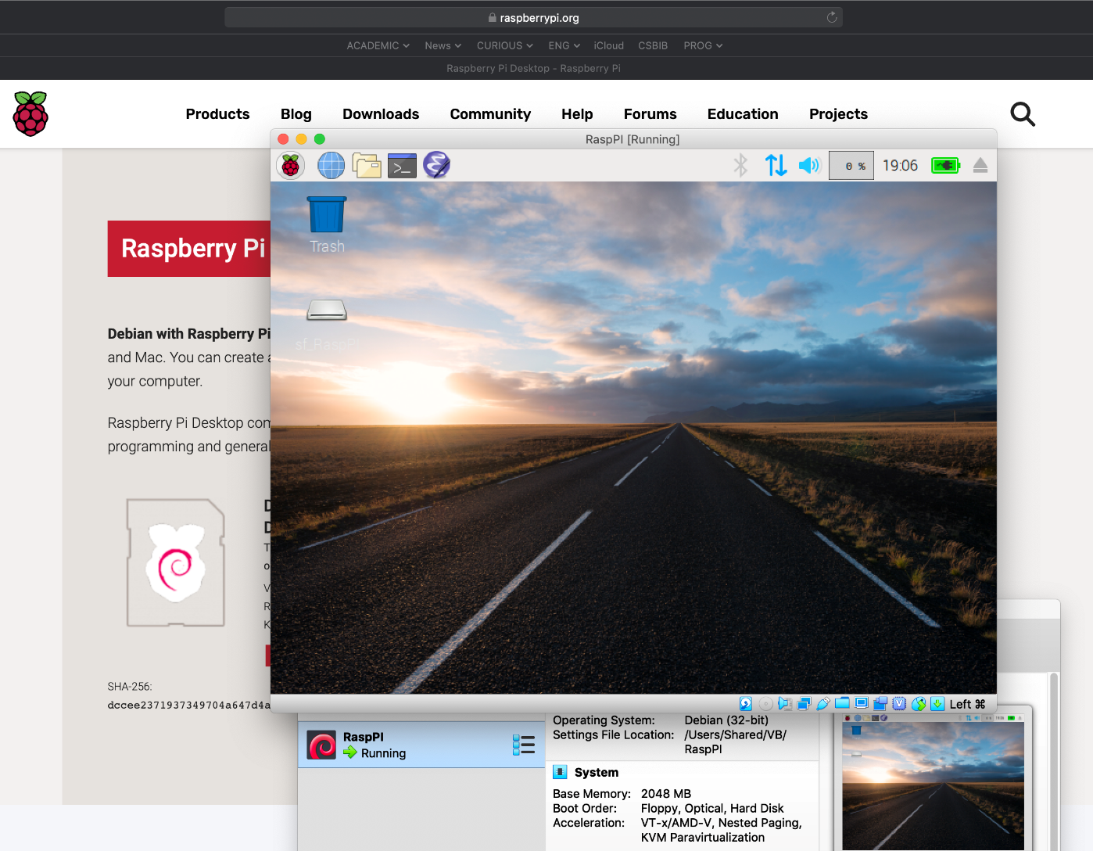
Virtual Box
Computer
The software we use in this course runs on a virtual computer that runs as software on your computer
The virtual computer is a (virtual) Raspberry PI
Virtual Computer
Virtual Box

Slide 25
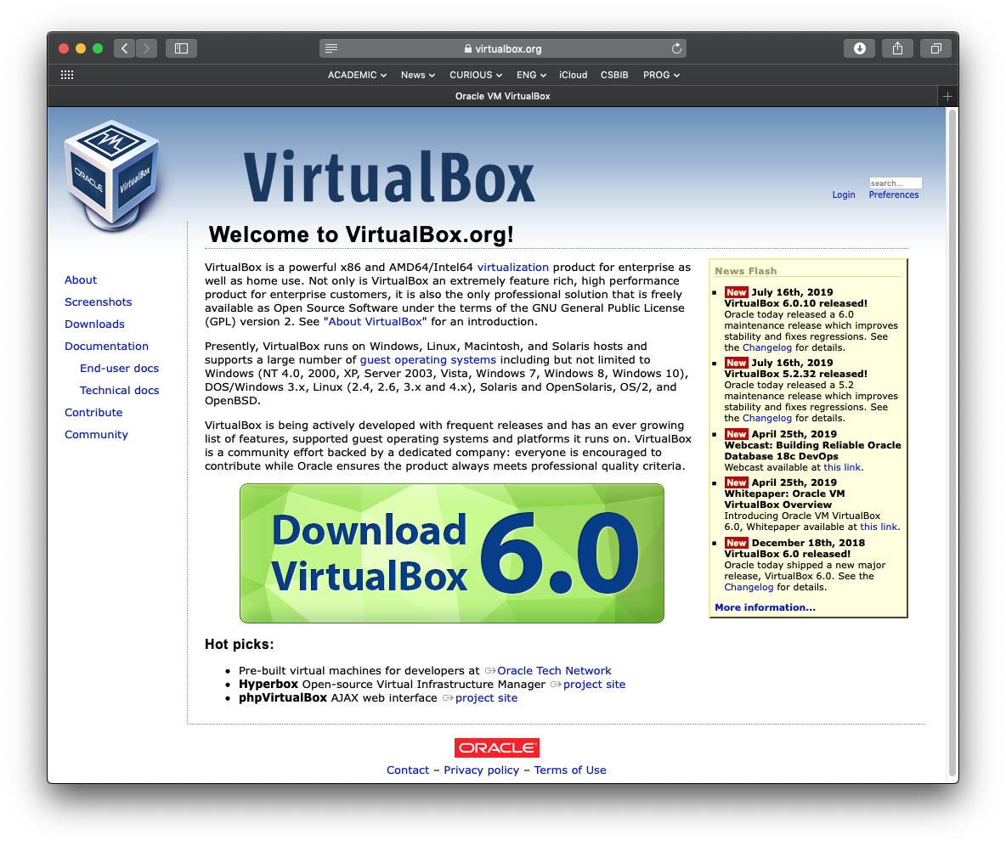
Virtual Box
You need to install Virtual Box on your computer
Link: https://www.virtualbox.org

Slide 26
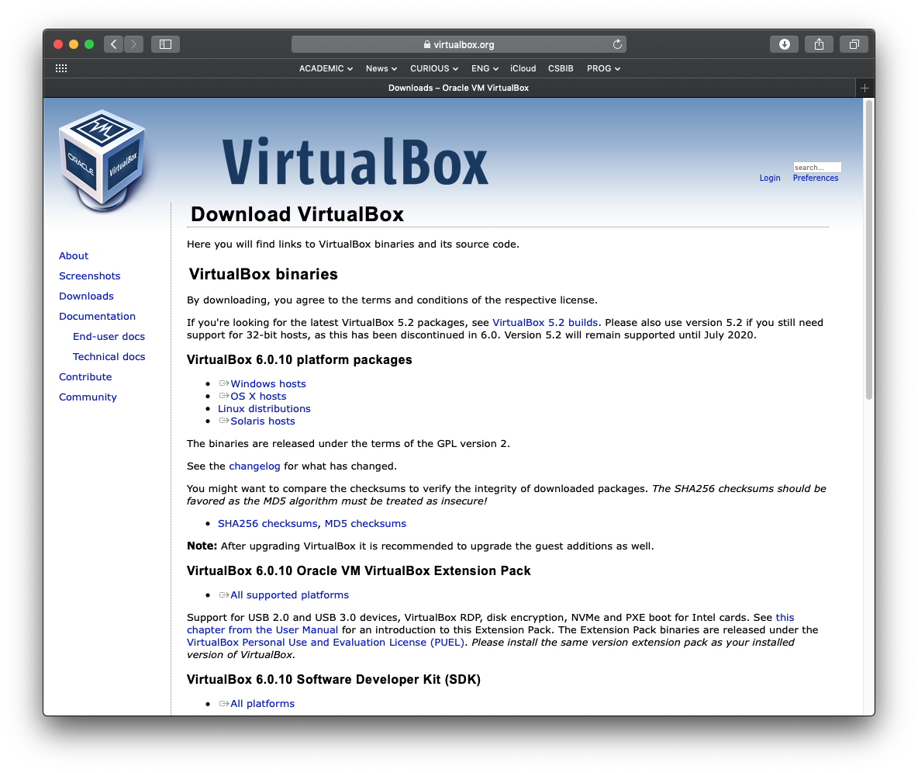
Virtual Box
… and the Virtual Box Extension Pack
Run the Virtual Box Installer, then install the Extension Pack
Further instructions can be found on the web page:
Link: https://www.virtualbox.org/wiki/Downloads

Slide 27
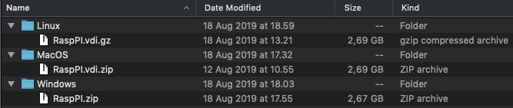
Virtual Box disk image
On the distributed USB stick you can find a disk image for your computer
Copy the corresponding disk image to your computer
Unpack it
If for some reason your disk image gets damaged during this course we will provide you with a new one

Slide 28
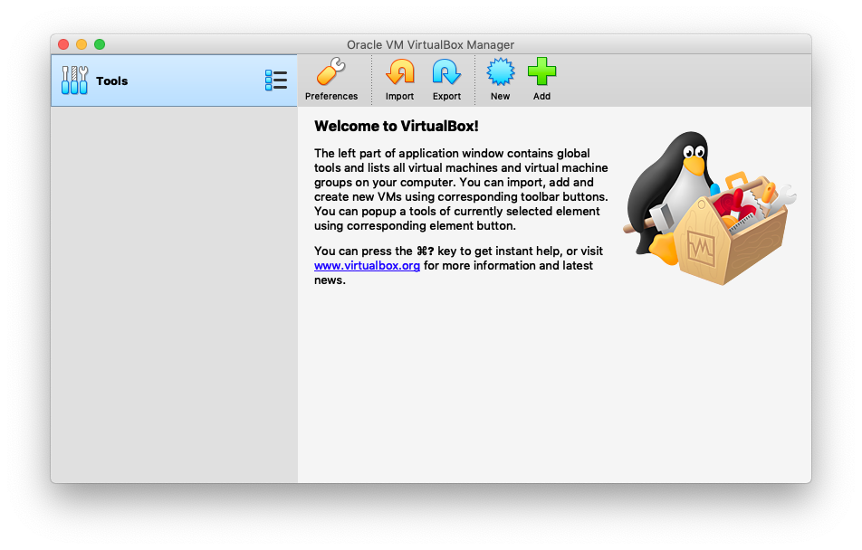
Set up Virtual Box
Start Virtual Box and click on the ‘New’ symbol at the top

Slide 29
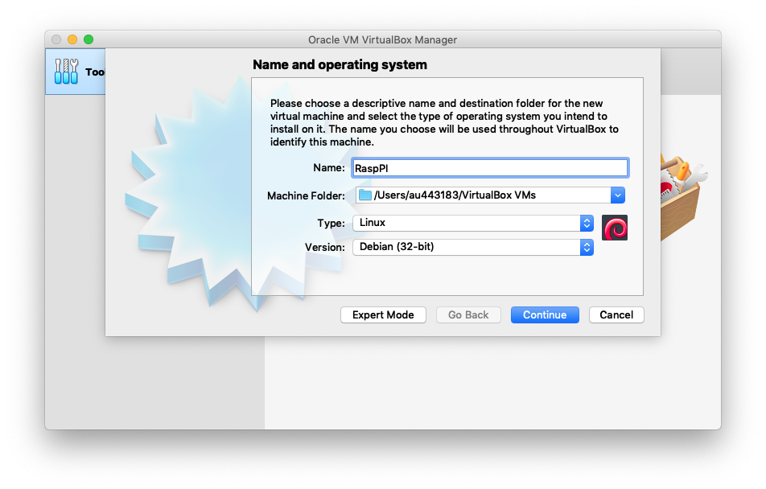
Set up Virtual Box
Choose a name, “Linux” and “Debian (32-bit)”
The Machine Folder specifies where the machine is stored on your computer (you can also just keep the default value!)
Click on “Continue”

Slide 30
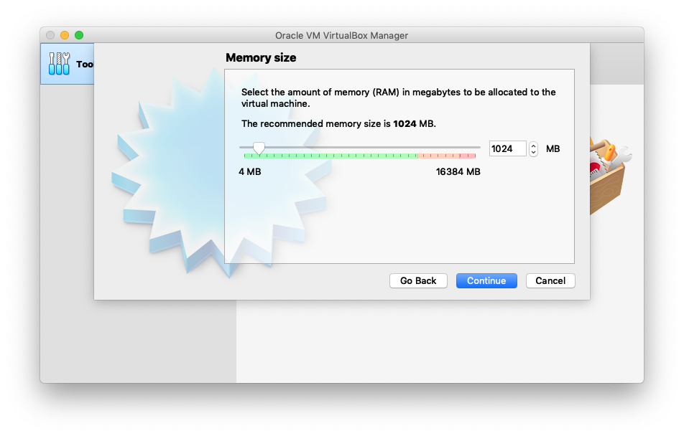
Set up Virtual Box
Click “Continue” again

Slide 31
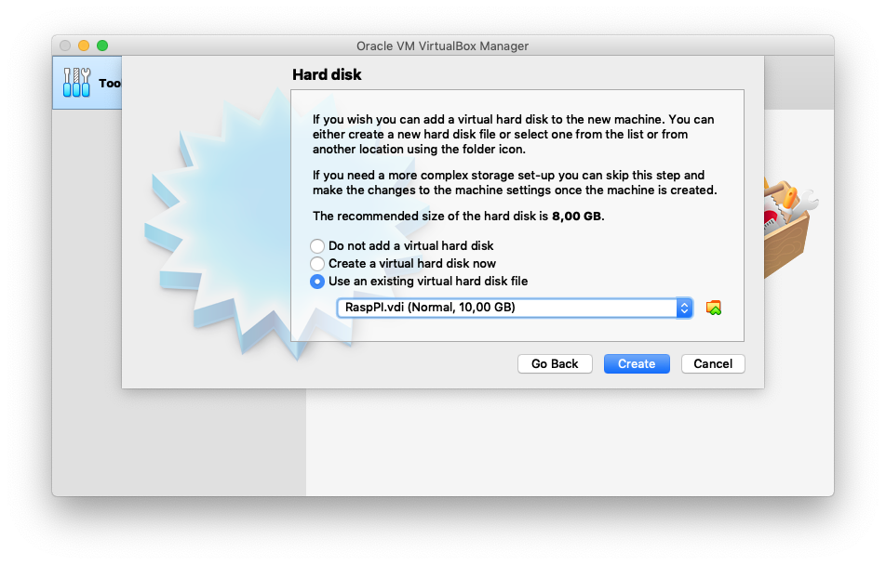
Set up Virtual Box
Choose the disk image that you have unpacked and click “Create”

Slide 32
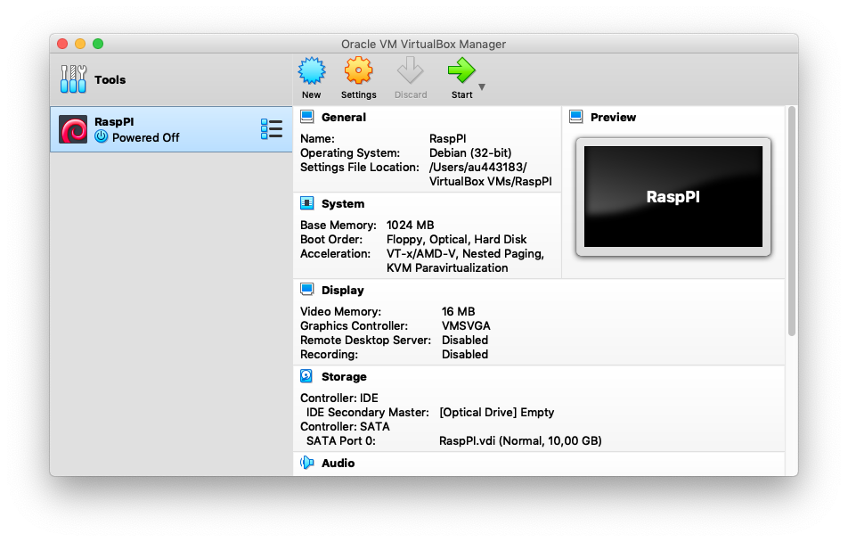
Set up Virtual Box
Click on “Start” to start it
The virtual computer is ready now

Slide 33
Agenda
Admin information about the course
Software Installation
Our first C program
The C language elements introduced today
Syntax and evaluation internally
Abstraction and programming

Slide 34
Example of a C program
Preprocessor directive to include standard header file
Comments
explain the purpose of the program, how and why it works
Preprocessor directive to define a constant
Variables
Function main program body
Special symbols
Standard identifiers
Reserved word
Punctuation
volume.c

Slide 35
Structure of the C program
This is the structure that you should use for your weekly exercises, in general.
Input of the program
Computation (of the volume)
Output of the program

Slide 36
Execution of the C program
The program needs to be compiled into a machine executable format ‘a.out’.
Then a.out is executed as illustrated below.
>gcc volume.c
>a.out
4
6
8
The volume is 94.
a.out
gcc
a.out
compiler
compiled program
Notes:
This should be demoed in a terminal window, compiling the source ‘volume.c’, then executing ‘a.out’.

Slide 37

Notes:
LiveSlide https://www.mentimeter.com/s/fe0f70b8ffb29c1a9de9bfcc510ba870/f9eddc453796

Slide 38
Notes:
LiveSlide https://www.mentimeter.com/s/fe0f70b8ffb29c1a9de9bfcc510ba870/d7ed21902369

Slide 39
Agenda
Admin information about the course
Software Installation
Our first C program
The C language elements introduced today
Syntax and evaluation internally
Abstraction and programming

Slide 40
Language elements
Comments
Pre-processor directives
Inclusion of header files
Definition of constants
The main function
Identifiers and symbols
Expressions and expression evaluation
Variables and types
Executable statements:
Assignment statements
Sequences of statements
Return statements
Conditional statements

Slide 41
Comments
Begins with /* and ends with */
Ignored by the compiler (and during program execution)
Should provide information that is not evident from the program text itself
Description of the purpose of the program
Explanation of how it works and why it works
But also information pertaining to the program development itself, e.g.,
/* TODO: this needs to be implemented next */
/* FIXME: an error occurs here if variable x is negative */

Slide 42
Preprocessor directives
Preprocessor directive:
A C program line beginning with #
that provides an instruction
to the pre-processor
#include <stdio.h>
#define CAVITY 98
Definitions made in stdio.h
gcc –E volume.c
The C program with CAVITY replaced by 98
Notes:
This should also be demoed using the command ‘gcc -E volume.c’

Slide 43
The main function
The main function tells the compiler where the execution of the C program should begin
Usually it has the shape int main(void) { … }

Slide 44
identifiers
In a C programs all kinds of things are named by identifiers
We have seen identifiers in the example:
CAVITY, height user-defined identifiers
main user-defined identifier with specific meaning
scanf standard identifier
return reserved word
Identifiers
consist of letters, digits and underscores (”_”)
must not begin with a digit

Slide 45
Special symbols & Punctuation
Punctuations are used to separate and structure C programs like , ; { }
Special symbols (like = * - ) are used to improve readability of programs
For instance, volume = height * length * width – CAVITY is more readable than assign(volume, subtract(multiply(multiply(height,length),width), CAVITY) would be
Other examples of special symbols are < smaller <= at most, smaller or equal > larger >= at least, larger or equal

Slide 46
Standard identifiers
Some identifiers are are used by the standard libraries such as stdio.h
These are expected by programmers to have the “expected” meaning
We have seen scanf to input values of variables and printf to output values of variables (and accompanying text)
Information on meaning of standard identifiers, e.g., printf: > man printf

Slide 47
User-defined identifiers
User-defined identifiers are identifiers that
name constants, variables and functions in C programs
must not be reserved words
should not be standard identifiers
Violating point 3 above makes programs very difficult to read
In general, identifiers should be chosen that improve readability

Slide 48
Notes:
LiveSlide https://www.mentimeter.com/s/fe0f70b8ffb29c1a9de9bfcc510ba870/21ab2dabeb52

Slide 49
Agenda
Admin information about the course
Software Installation
Our first C program
The C language elements introduced today
Syntax and evaluation internally
Abstraction and programming

Slide 50
Syntax
Concrete syntax
This the program text from a text file, e.g., 4 * 6 * 8 - 98
Abstract syntax
This is a structured representation of the program text usually represented as a tree
The abstract syntax tree corresponds to the bracketed text ((4 * 6) * 8) - 98
4
6
*
8
*
98
-

Slide 51
Expressions
An expression is a syntactic object that has a value
In C expressions are implicitly parenthesised to reduce the number of parentheses in program text, e.g., 4 * 6 * 8 corresponds to (4 * 6) * 8
On the last slide we have seen that (4 * 6) * 8 corresponds directly to the abstract syntax
Sometimes fully bracketed expressions such as (4 * 6) * 8 are referred to as abstract syntax, reading it as the graphical tree from the preceding slide

Slide 52
Expression evaluation
The expression ((4 * 6) * 8) - 98 with constant values only is evaluated abstractly as follows

Slide 53
Expression evaluation
The expression ((4 * 6) * 8) - 98 with constant values only is evaluated abstractly as follows

Slide 54
Expression evaluation
The expression ((4 * 6) * 8) - 98 with constant values only is evaluated abstractly as follows

Slide 55
Expression evaluation
The expression ((4 * 6) * 8) - 98 with constant values only is evaluated abstractly as follows

Slide 56
Compilation and evaluation
Of course, a computer does not evaluate the expression abstractly
The compiler translates the program containing the expression into a machine executable format
These formats of the program are difficult to understand
The C language frees us – to a large degree – from having to think in terms of what the computer does
Assembly Language
Machine Language

Slide 57
Thinking abstractly
The compiler ensures that the machine evaluation is faithful to the abstract evaluation
This permits us to think abstractly in terms of a C program and ignore the machine evaluation
And that is what we are going to do!
Input
C Program
abstract evaluation
machine evaluation
Output

Slide 58
Variables
Variables store values that may change over time (as opposed to constants whose values do not change)
The values of variables are changed by assignment statements discussed later
Variable declarations provide a name and information about possible values of the variable being declared
A variable declaration consists of an identifier followed by a type describing possible values, e.g., int volume;
Each variable in a C program must be declared before its first use

Slide 59
Types
The following types are built into the C language:
int the type of integer numbers
bool the type of Boolean values true and false (requires use of #include <stdbool.h>)
char the type characters (letters, digits and other symbols)
double the type of floating point numbers
There are more types available but we will not use them in this lecture
We will focus on int, bool and char
The type double will be treated in more detail in the 2nd semester lecture Numerical Linear Algebra

Slide 60
Integer values
The values that can be assumed by a variable of type in lie in the range from INT_MIN to INT_MAX
The value of the constant INT_MIN is −32,767 or smaller
The value of the constant INT_MAX is +32,767 or larger
int_range.c

Slide 61
Character values
Character values are written in high quotes, e.g.,
‘a’
‘%’
‘5’
Note that 5 is different from ‘5’
The first is an integer number of type int
The second is a character of type char

Slide 62
Operators for boolean expressions
Equality and inequality have values of type bool
Expression | Meaning
x && y, x || y | Conjunction (and), disjunction (or)
!x | negation
x ? a : b | Conditional expression, yields a if x is true, b otherwise
x == y, x != y | Equality, inequality

Slide 63
Operators for integer expressions
Equality, inequality and integer comparisons have values of type bool
Expression | Meaning
x + y, x – y, x * y | Addition, subtraction, multiplication
x / y | Integer division: 1 / 2 equals 0
x % y | Integer division remainder, same sign as x
+x, -x | Unary sign operators
x == y, x != y | Equality, inequality
x < y, x <= y, x > y, x >= y | Integer comparisons

Slide 64
Executable statements
In C programs all statements are terminated with a ;
Assignment statements
x = y;
Warning: a common error is to write = when == is meant!
Sequences of statements
x = y; printf(“%d”,x);
Return statements
return 0;
Conditional statements

Slide 65
Assignment statement
An assignment stores the value of an expression in a variable
x = y stores the value of y in variable x
x = y + z stores the value of the sum of the values of x and y
Note, that this means that if y or z are variables themselves their values are retrieved first

Slide 66
Execution of an assignment
To execute x = expression
Variables in the expression are evaluated by retrieving their values
Otherwise the expression is evaluated as discussed earlier
Once the expression has been fully evaluated, its value is stored in the variable x on the left-hand side of the assignment statement
Now we are ready to explain the execution of the assignment
volume = ((height * length) * width) - 98

Slide 67
example
Execution of volume = ((height * length) * width) - 98
Variable values before execution
Expression
Variable values after execution

Slide 68
example
Execution of volume = ((height * length) * width) - 98
Variable values before execution
Expression
Variable values after execution

Slide 69
example
Execution of volume = ((height * length) * width) - 98
Variable values before execution
Expression
Variable values after execution

Slide 70
example
Execution of volume = ((height * length) * width) - 98
Variable values before execution
Expression
Variable values after execution

Slide 71
example
Execution of volume = ((height * length) * width) - 98
Variable values before execution
Expression
Variable values after execution

Slide 72
example
Execution of volume = ((height * length) * width) - 98
Variable values before execution
Expression
Variable values after execution

Slide 73
example
Execution of volume = ((height * length) * width) - 98
Variable values before execution
Expression
Variable values after execution

Slide 74
example
Execution of volume = ((height * length) * width) - 98
Variable values before execution
Expression
Variable values after execution

Slide 75
example
Execution of volume = ((height * length) * width) - 98
Variable values before execution
Expression
Variable values after execution

Slide 76
example
Execution of volume = ((height * length) * width) - 98
Assembly Language
Machine Language
push rbp
mov rbp,rsp
mov edx,DWORD PTR [rip+0x200b70]
mov eax,DWORD PTR [rip+0x200b6e]
imul edx,eax
mov eax,DWORD PTR [rip+0x200b69]
imul eax,edx
sub eax,0x62
mov DWORD PTR [rip+0x200b61],eax
mov eax,DWORD PTR [rip+0x200b5b]
pop rbp
55
48 89 e5
8b 15 70 0b 20 00
8b 05 6e 0b 20 00
0f af d0
8b 05 69 0b 20 00
0f af c2
83 e8 62
89 05 61 0b 20 00
8b 05 5b 0b 20 00
5d

Slide 77
example
Execution of volume = ((height * length) * width) - 98
Assembly Language
push rbp
mov rbp,rsp
mov edx,DWORD PTR [rip+0x200b70]
mov eax,DWORD PTR [rip+0x200b6e]
imul edx,eax
mov eax,DWORD PTR [rip+0x200b69]
imul eax,edx
sub eax,0x62
mov DWORD PTR [rip+0x200b61],eax
mov eax,DWORD PTR [rip+0x200b5b]
pop rbp

Slide 78
example
Execution of volume = ((height * length) * width) - 98
Assembly Language
push rbp
mov rbp,rsp
mov edx,DWORD PTR [rip+0x200b70]
mov eax,DWORD PTR [rip+0x200b6e]
imul edx,eax
mov eax,DWORD PTR [rip+0x200b69]
imul eax,edx
sub eax,0x62
mov DWORD PTR [rip+0x200b61],eax
mov eax,DWORD PTR [rip+0x200b5b]
pop rbp

Slide 79
example
Execution of volume = ((height * length) * width) - 98
Assembly Language
push rbp
mov rbp,rsp
mov edx,DWORD PTR [rip+0x200b70]
mov eax,DWORD PTR [rip+0x200b6e]
imul edx,eax
mov eax,DWORD PTR [rip+0x200b69]
imul eax,edx
sub eax,0x62
mov DWORD PTR [rip+0x200b61],eax
mov eax,DWORD PTR [rip+0x200b5b]
pop rbp

Slide 80
example
Execution of volume = ((height * length) * width) - 98
Assembly Language
push rbp
mov rbp,rsp
mov edx,DWORD PTR [rip+0x200b70]
mov eax,DWORD PTR [rip+0x200b6e]
imul edx,eax
mov eax,DWORD PTR [rip+0x200b69]
imul eax,edx
sub eax,0x62
mov DWORD PTR [rip+0x200b61],eax
mov eax,DWORD PTR [rip+0x200b5b]
pop rbp

Slide 81
example
Execution of volume = ((height * length) * width) - 98
Assembly Language
push rbp
mov rbp,rsp
mov edx,DWORD PTR [rip+0x200b70]
mov eax,DWORD PTR [rip+0x200b6e]
imul edx,eax
mov eax,DWORD PTR [rip+0x200b69]
imul eax,edx
sub eax,0x62
mov DWORD PTR [rip+0x200b61],eax
mov eax,DWORD PTR [rip+0x200b5b]
pop rbp

Slide 82
example
Execution of volume = ((height * length) * width) - 98
Assembly Language
push rbp
mov rbp,rsp
mov edx,DWORD PTR [rip+0x200b70]
mov eax,DWORD PTR [rip+0x200b6e]
imul edx,eax
mov eax,DWORD PTR [rip+0x200b69]
imul eax,edx
sub eax,0x62
mov DWORD PTR [rip+0x200b61],eax
mov eax,DWORD PTR [rip+0x200b5b]
pop rbp

Slide 83
example
Execution of volume = ((height * length) * width) - 98
Assembly Language
push rbp
mov rbp,rsp
mov edx,DWORD PTR [rip+0x200b70]
mov eax,DWORD PTR [rip+0x200b6e]
imul edx,eax
mov eax,DWORD PTR [rip+0x200b69]
imul eax,edx
sub eax,0x62
mov DWORD PTR [rip+0x200b61],eax
mov eax,DWORD PTR [rip+0x200b5b]
pop rbp

Slide 84
example
Execution of volume = ((height * length) * width) - 98
Assembly Language
push rbp
mov rbp,rsp
mov edx,DWORD PTR [rip+0x200b70]
mov eax,DWORD PTR [rip+0x200b6e]
imul edx,eax
mov eax,DWORD PTR [rip+0x200b69]
imul eax,edx
sub eax,0x62
mov DWORD PTR [rip+0x200b61],eax
mov eax,DWORD PTR [rip+0x200b5b]
pop rbp

Slide 85
example
Execution of volume = ((height * length) * width) - 98
Assembly Language
push rbp
mov rbp,rsp
mov edx,DWORD PTR [rip+0x200b70]
mov eax,DWORD PTR [rip+0x200b6e]
imul edx,eax
mov eax,DWORD PTR [rip+0x200b69]
imul eax,edx
sub eax,0x62
mov DWORD PTR [rip+0x200b61],eax
mov eax,DWORD PTR [rip+0x200b5b]
pop rbp

Slide 86
example
Execution of volume = ((height * length) * width) - 98
Assembly Language
push rbp
mov rbp,rsp
mov edx,DWORD PTR [rip+0x200b70]
mov eax,DWORD PTR [rip+0x200b6e]
imul edx,eax
mov eax,DWORD PTR [rip+0x200b69]
imul eax,edx
sub eax,0x62
mov DWORD PTR [rip+0x200b61],eax
mov eax,DWORD PTR [rip+0x200b5b]
pop rbp
In fact, the computer might change the order in which these commands are executed somewhat
You will learn about this in the Computer Architecture course in the 2nd semester

Slide 87
assignment statements Short forms
You will see the short forms often being used in C programs.
Short form | Long form
x += n | x = x + n
x++ | x = x + 1
x -= n | x = x – n
x-- | x = x - 1
x *= n | x = x * n
x /= n | x = x / n

Slide 88
Notes:
LiveSlide https://www.mentimeter.com/s/fe0f70b8ffb29c1a9de9bfcc510ba870/30a820a204b1

Slide 89
Agenda
Admin information about the course
Software Installation
Our first C program
The C language elements introduced today
Syntax and evaluation internally
Abstraction and programming

Slide 90
Abstraction and programming
Our abstract view of evaluation and execution is faithful to the commands that are eventually executed by the computer
We will abstract a little more and only look at statements before and after execution
We will ignore how expressions are evaluated
We will write our programs in an adequate form to permit this
This is the key to reasoning about the properties of our programs
We think of programming as problem solving
Reasoning about programs is necessary to understand whether they solve a given problem

Slide 91
Sequences of statements
We have already seen that programs are usually composed of sequences of statements, e.g., x = 1; x = x + 1;
The statements are executed in the order they are specified.
First x = 1; is executed. After the execution of this statement variable x stores the value 1.
Then x = x + 1; is executed. After the execution of this statement variable x stores the value 2.

Slide 92
Input of values (into variables)
The function scanf available from <stdio.h> reads values from the terminal and stores them into variables
scanf(“%d”,&var) reads an integer number from the terminal and stores it in the variable var

Slide 93
Output of values
The function printf available from <stdio.h> writes values to the terminal
printf(“%d”,var) writes the integer value of var to the terminal
Both scanf and printf use placeholders like %d to specify what is supposed to be read or written
In printf we often use several place holders, e.g., “%d ... %d” and provide the variables or constants to be written in the corresponding order as in
printf(“%d ... %d”, min, max)

Slide 94
Common placeholders
Placeholder | Variable Type | Function Use
%c | char | printf/scanf
%d | int | printf/scanf
%f | double | printf
%lf | double | scanf

Slide 95
The return statement
The return statement specifies the result of a function
e.g., return 0
or no result
e.g., return
We have only seen it in function main until now
The return statement ends the execution of a function at the position of the return statement
gcc return.c > ./a.out Before the return statement

Slide 96
Conditional statements
A conditional statement has the shape
if (condition) statement to be executed if the condition is true else statement to be executed if the condition is false
Alternatively,
if (condition) statement to be executed if the condition is true
Which corresponds to saying: “else do nothing”
We often refer to conditional statements as if-statements

Slide 97
the maximum of two integer numbers
The following program computes the maximum of two integer numbers
The following happens when this fragment is executed:
The expression x <= y is evaluated
If the value of the expression is true, the first branch of the conditional statement is executed, that is, the value of y is stored in variable max
If the value of the expression is false, the second branch of the conditional statement is executed, that is, the value of x is stored in max
maxvalue.c

Slide 98
Aside: Evaluation Errors
Not every expression has a defined result, e.g., division by zero
What can we do about this?
> gcc rt_error.c > ./a.out
Floating point exception

Slide 99
Solution 1: conditional statement
We could check the value of 2 * x – x – x using a conditional statement as shown below
Now the error has disappeared.
The program checks whether 2 * x – x – x != 0
And carries out the division only that case.
However, this solution is unsatisfactory.
We calculate,
2 * x – x – x = 2 * x – (x + x) = 2 * x – 2 * x = 0 .
So, the program on the left is the same as:

Slide 100
Solution 2: discard the program
The reasoning about the program showed that in the expression 2 * x – x – x always yields the value 0. This is not a meaningful program.
It does not appear to a solve any problem.

Slide 101
Reasoning and problem solving
In this lecture we will consider programs as solutions to problems
We will check this by reasoning about the programs we write
All too often we are tempted to write programs (such as the one just shown) without understanding the problem or the program
This often results in meaningless programs, although occasionally we might be lucky and the program might do something interesting (albeit unexpected)

Slide 102
Notes:
LiveSlide https://www.mentimeter.com/s/8df716d84a1f728a248ed0d06b7281bf/703d740d0b1b

